Slide 1
Deep Q-Network
Pugin Kirill
Raykovskiy Daniil
group 307

Slide 2
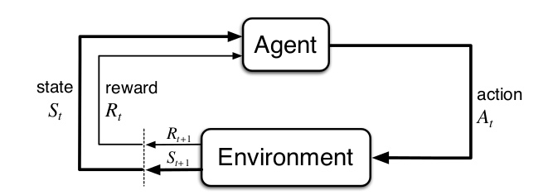
Problem statement in RL
The goal of RL agent is to learn a policy $π:S→A$ which maximizes the expected cumulative reward

Slide 3
Ours case The cart pole balancing problem

Slide 4
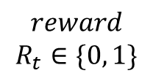
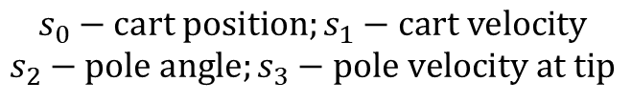
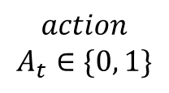


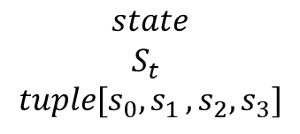
The cart pole balancing problem
Cart
$$state$$
$$S_{t}$$
$$tuple[s_{0}{,s}_{1},s_{2},s_{3}]$$
$$reward$$
$$R_{t}∈\{0, 1\}$$
$$action$$
$$A_{t}∈\{0, 1\}$$
$$R_{t+1}$$
Environment
$$S_{t+1}$$
$$s_{0}−cart position;s_{1}−cart velocity$$
$$s_{2}−pole angle;s_{3}−pole velocity at tip$$

Slide 5

Q-learning main idea
If we had a value-action function $Q^{∗}$: $S×A→R$,
then $π^{∗}\left(s\right)=\underset{a}{argmax}{Q^{∗}(s,a)}$

Slide 6
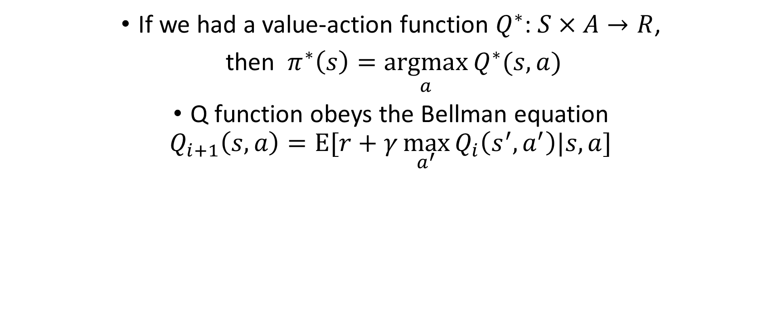
Q-learning main idea
If we had a value-action function $Q^{∗}$: $S×A→R$,
then $π^{∗}\left(s\right)=\underset{a}{argmax}{Q^{∗}(s,a)}$
Q function obeys the Bellman equation
$$Q_{i+1}\left(s,a\right)=E[r+γ\max_{a^{′}}{Q_{i}\left(s^{′},a^{′}\right)|s,a]}$$

Slide 7
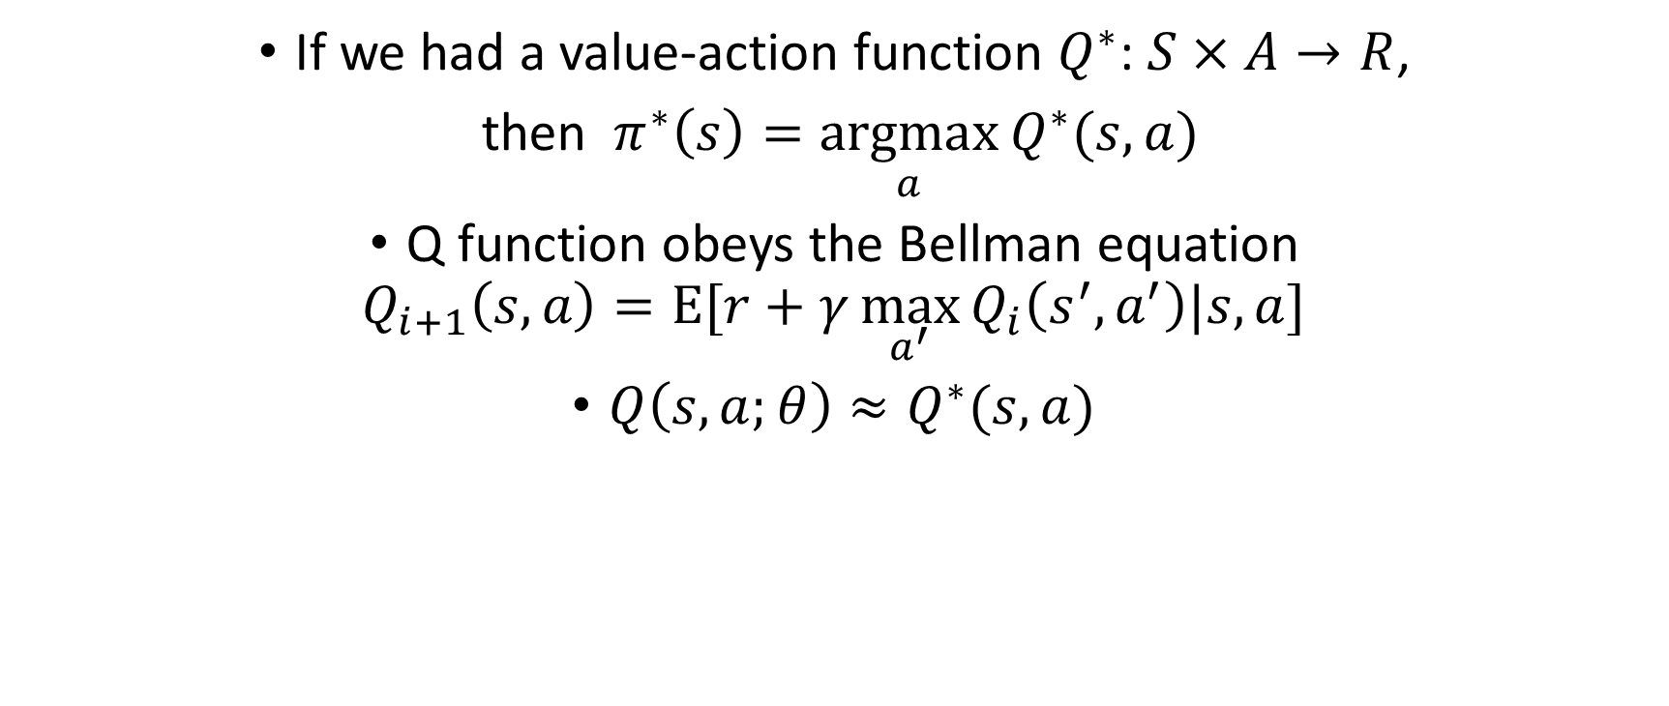
Q-learning main idea
If we had a value-action function $Q^{∗}$: $S×A→R$,
then $π^{∗}\left(s\right)=\underset{a}{argmax}{Q^{∗}(s,a)}$
Q function obeys the Bellman equation
$$Q_{i+1}\left(s,a\right)=E[r+γ\max_{a^{′}}{Q_{i}\left(s^{′},a^{′}\right)|s,a]}$$
$Q\left(s,a;θ\right)≈Q^{∗}(s,a)$

Slide 8
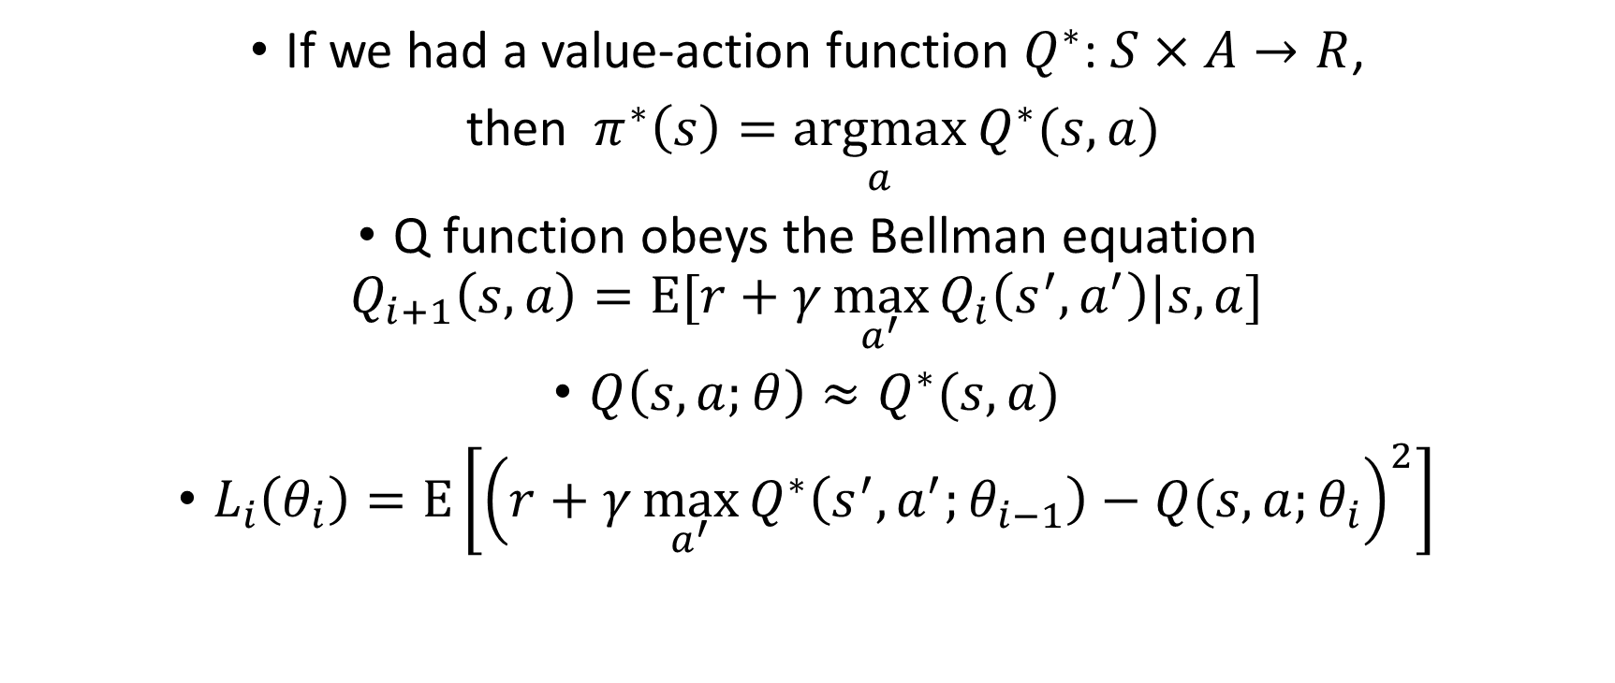
Q-learning main idea
If we had a value-action function $Q^{∗}$: $S×A→R$,
then $π^{∗}\left(s\right)=\underset{a}{argmax}{Q^{∗}(s,a)}$
Q function obeys the Bellman equation
$$Q_{i+1}\left(s,a\right)=E[r+γ\max_{a^{′}}{Q_{i}\left(s^{′},a^{′}\right)|s,a]}$$
$Q\left(s,a;θ\right)≈Q^{∗}(s,a)$
$L_{i}\left(θ_{i}\right)=E\left[{\left(r+γ\max_{a^{′}}{Q^{∗}\left(s^{′},a^{′};θ_{i−1}\right)−Q(s,a;θ_{i}}\right)}^{2}\right]$

Slide 9
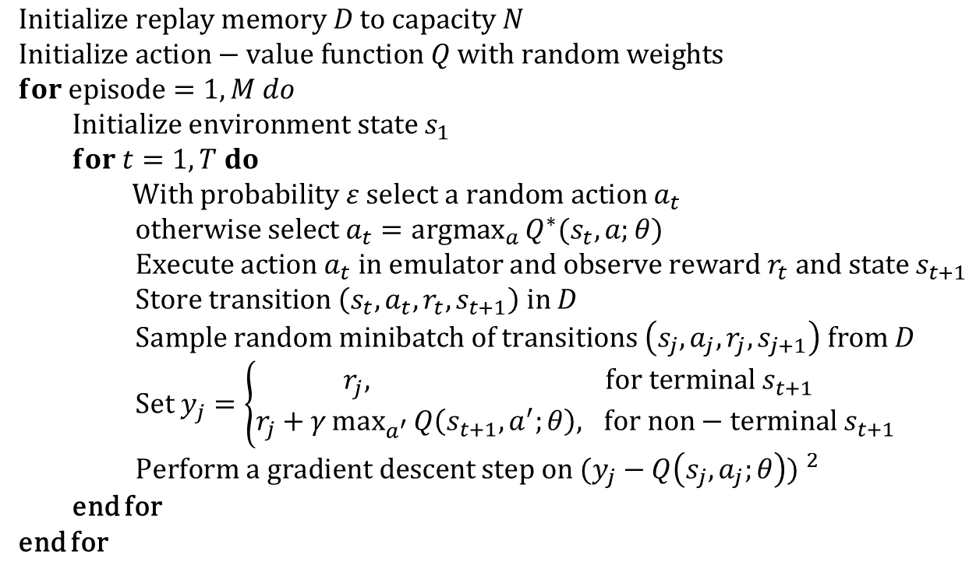
Algorithm’s pseudo-code
$$Initialize replay memory D to capacity N$$
$$Initialize action−value function Q with random weights$$
$$for episode=1, M do$$
$Initialize environment state s_{1}$
$for t=1, T do$
$With probability ε select a random action a_{t}$
$otherwise select a_{t}=\underset{a}{argmax}{Q^{∗}(s_{t}, a;θ)}$
$Execute action a_{t} in emulator and observe reward r_{t} and state s_{t+1}$
$Store transition \left(s_{t},a_{t},r_{t},s_{t+1}\right) in D$
$Sample random minibatch of transitions \left(s_{j},a_{j},r_{j},s_{j+1}\right) from D$
$Set y_{j}=\left\{\begin{aligned}r_{j}, for terminal s_{t+1} \\ r_{j}+γ\max_{a^{′}}{Q\left(s_{t+1},a^{′};θ\right), for non−terminal{ s}_{t+1} }\end{aligned}\right.$
$Perform a gradient descent step on {(y_{j}−Q\left(s_{j},a_{j};θ\right)) }^{2}$
end for
end for

Slide 10
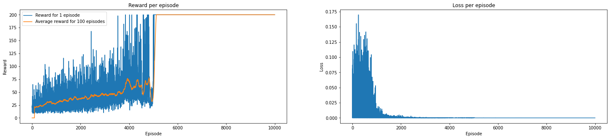
Evaluation

Slide 11
Evaluation
Agent performs random actions

Slide 12
Evaluation
Agent performs actions in accordance with the optimal policy
(10,000 episodes of training)

Slide 13
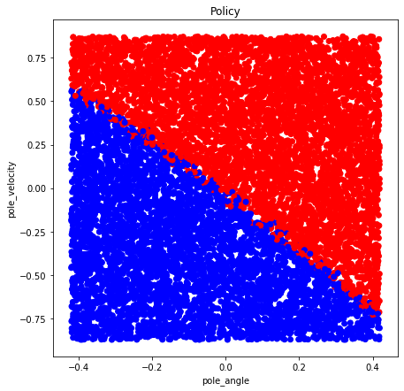

Slide 14
GitHub repository
https://github.com/Rijkaa/DQN

